Slide 1
Light Field Imaging Toolbox

Slide 2
Design goals
Modular
Extensible
Interfaces and implementations
APIs/SPIs... accessible from notebooks or napari
Interoperable
Light Field Imaging (napari plugin)
adapters to ImageJ, ImgLib2, Bioformats,

Slide 3
Modules
design interfaces for the entire workflow, regardless of implemention
LFAcquire (using umgr?, later)
LFMeta, LFData
LFData.import, transform
LFCalibrate
LFRectify
LFDeconvolution
LFDeepLearn, LFInference
LFView… LFDisplay

Slide 4
Data and Metadata
File / dataset naming
Containers / file formats
Metadata
LFMeta specify metadata req'd
LFData + utilizes LFMeta
napari metadata?

Slide 5
Files
<Sample folder>
Sample.lfm
…
….
RawLFImage.tif
stack
deconvolve
LF metadata, text
JSON
rectify
DarkImage.tif
Perspective
(subaperture)
calibrate
Calibration file
WhiteImage.tif

Slide 6
Files
May be files in a folder or datasets contained in HDF5 file.
Naming
Unique <sample> name
LF metadata file .lfm (text, JSON)
Tool to generate LFmeta
App to fill in values
acquisition system might create

Slide 7
GUI
Leveraging napari infrastructure…
GUI
MagicGUI
QtPy (abstraction layer over PyQT, PySide)
Leverage VizPy, Scikit-image, …
(Later…) Acquisition, camera control, drivers → Micromanager?

Slide 8
Input from LFAnalyse….

Slide 9
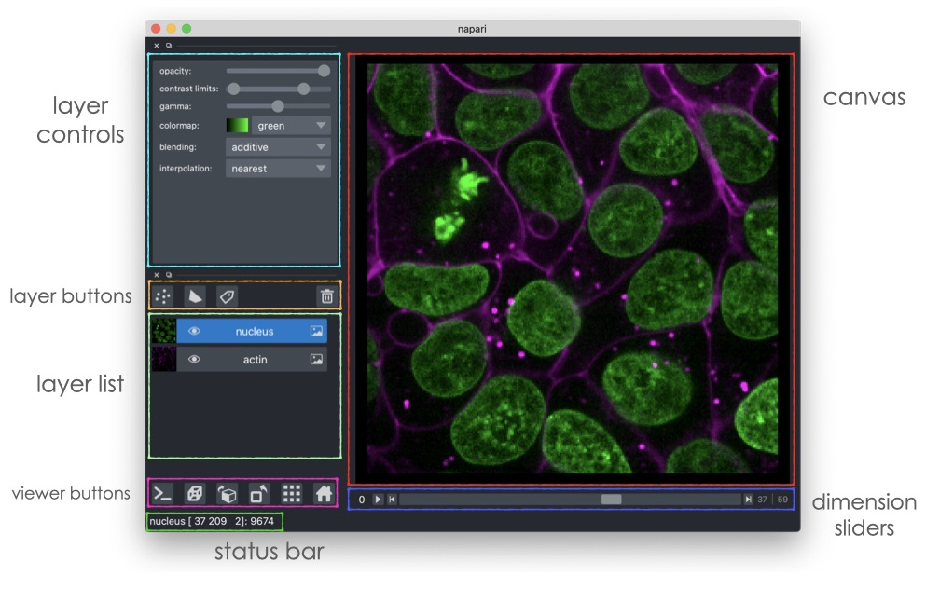
UI

Slide 10
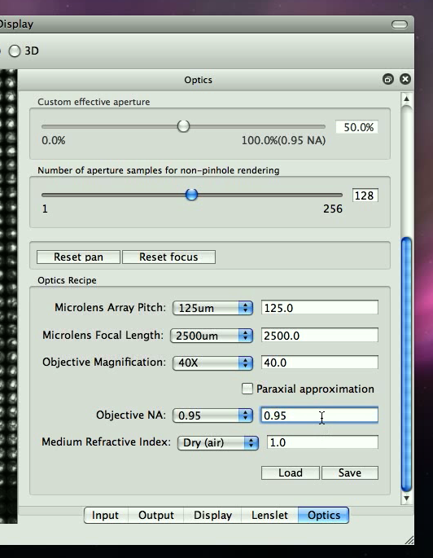
Optics [Config]

Slide 11
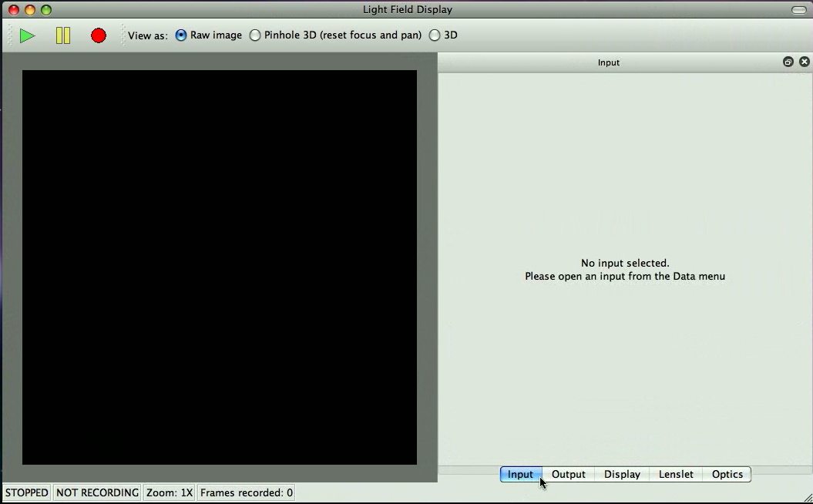

LFDisplay – Main window

Slide 12
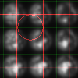
Lenslet

Slide 13
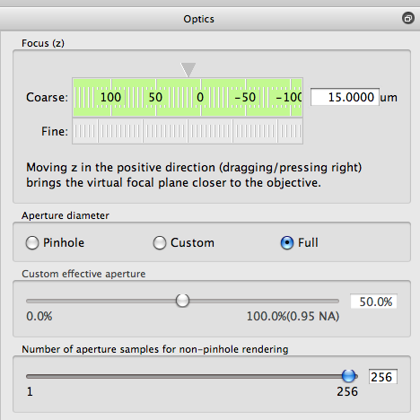
Optics [Explore]

Slide 14
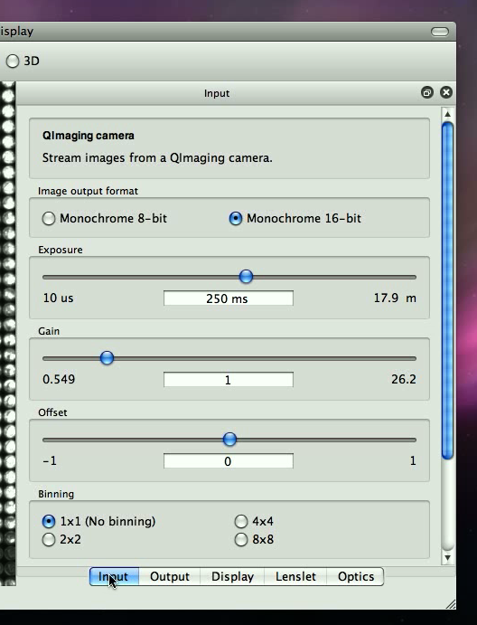
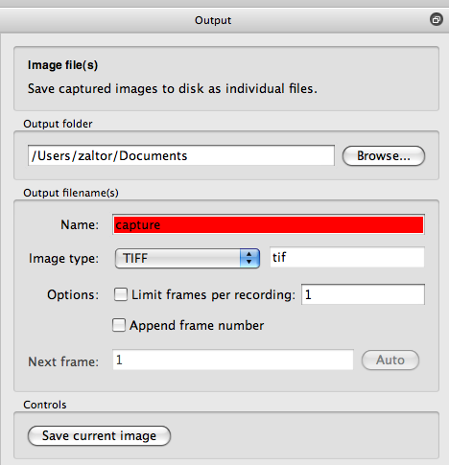
Input, Output
Camera control
Acquisition
File save

Slide 15
ImgNav…
Py version of ImgNav... in python?
add subdir organization and metadata/description/notes in file descibeme.
preview image. preview.tif [gif, jpg, png] with tiff [single|multiple page]]?
specify representative thumbnail
like a readme.

